Slide 1

Proposed Solution and Architecture for Automated Log Analysis
Presented by Quantizers
August 2, 2025

Slide 2



Solution Overview: AI-Driven On-Prem Log Analysis
Our proposed system leverages AI/ML for real-time log analysis and threat detection, operating entirely within your on-premise infrastructure. This ensures data sovereignty and minimal latency.
Real-time Threat Detection
On-Premise Deployment
AI/ML Core
Full control via Docker containerization on commodity hardware
Integrated with ELK stack for data normalization and visualization
Employs PyCaret for model tuning and optimization
Aims for <5% false positives using explainable AI techniques (SHAP)
Identify anomalies and potential threats as they occur.
Leveraging unsupervised ML (autoencoders) for novel threats like APTs.

Slide 3





System Architecture: Layered Approach
The architecture is designed in modular layers to ensure scalability, reliability, and clear separation of concerns, from data ingestion to user interface.
Data Ingestion, Processing, Analysis Flow
Collect logs → Clean and Transform(Grok Patterns in LogStash) → Analyse →
Isolation-Forest and Autoencoders for analysis → Generate Insights (XAI +
Llama summaries) → Alert (Voice alerts on dashboard)
Data Processing
Data Layer: ELK + PySpark for ingestion/parsing
ML Models
Analyze patterns and anomalies
Deployment
Ensures scalability for 10x load via Docker orchestration

Slide 4



Log Ingestion, Parsing, and Feature Extraction
The system ingests logs from diverse sources, normalises formats, and extracts critical features to feed the anomaly detection models.
Diverse Log Sources
Robust Parsing
Feature Extraction
Collects data from servers, network devices, applications, and security tools. Note: For now we are simulating this flow using RabbitMQ + Shell script + FastApi
Transforms unstructured log data into structured formats.
Extracts key attributes like User ID, IP Address, Timestamp, Event Type, and Severity for analysis.

Slide 5

AI/ML Models for Anomaly Detection
Central to the solution are AI/ML models trained for real-time anomaly detection, featuring adaptive self-learning capabilities for continuous improvement.
Real-time Anomaly Detection: Utilises supervised and unsupervised learning (e.g., Autoencoder model for detecting deviations from normal log patterns like unusual traffic spikes)
Model Training Pipeline: Continuous training with new data using TensorFlow/Keras tool for building and deploying models, adapting to evolving threats.
Ensemble Techniques: Combines multiple algorithms (e.g., Isolation Forest, Autoencoders) for enhanced accuracy.
Ensemble Techniques: Combines multiple algorithms (e.g., Isolation Forest, Autoencoders) for enhanced accuracy.
Adaptive Self-Learning: Models automatically refine via incremental retraining strategy on new log batches, reducing false positives over time
XAI: Explainable via SHAP strategy, providing feature importance (e.g., IP anomalies) for transparent detections
Visual Addition: Include a simple flowchart: Data Input → Autoencoder Model (TensorFlow/Keras) → Anomaly Score → Adaptive Retraining Loop

Slide 6


Generative AI for SOC Augmentation
GenAI integration enhances security operations with intelligent automation for threat understanding and response.
SOC Analyst Chatbot
"Auto Explain" Anomalies
An intelligent assistant for querying logs, threat intelligence, and incident response procedures using natural language.
Fine-tuned LLM (GPT-2 or Llama via Hugging Face) for natural language queries; On-prem with Llama.cpp for efficiency
Provides natural language explanations for detected anomalies, detailing context, potential impact, and suggested actions for analysts.
DDoS detected via traffic spikes'; Integrates with ML for context-aware insights

Slide 7
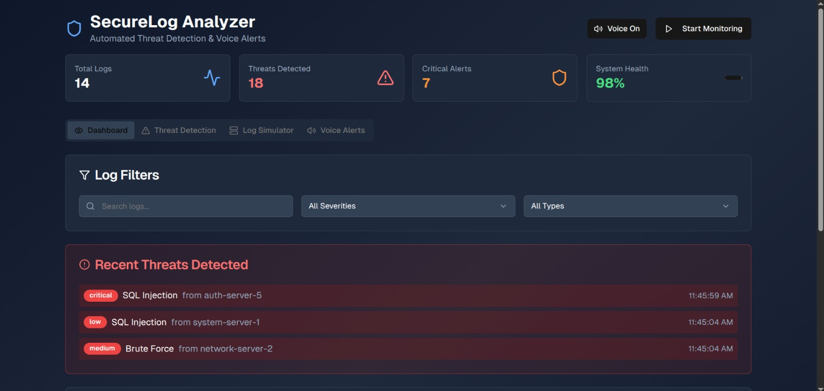
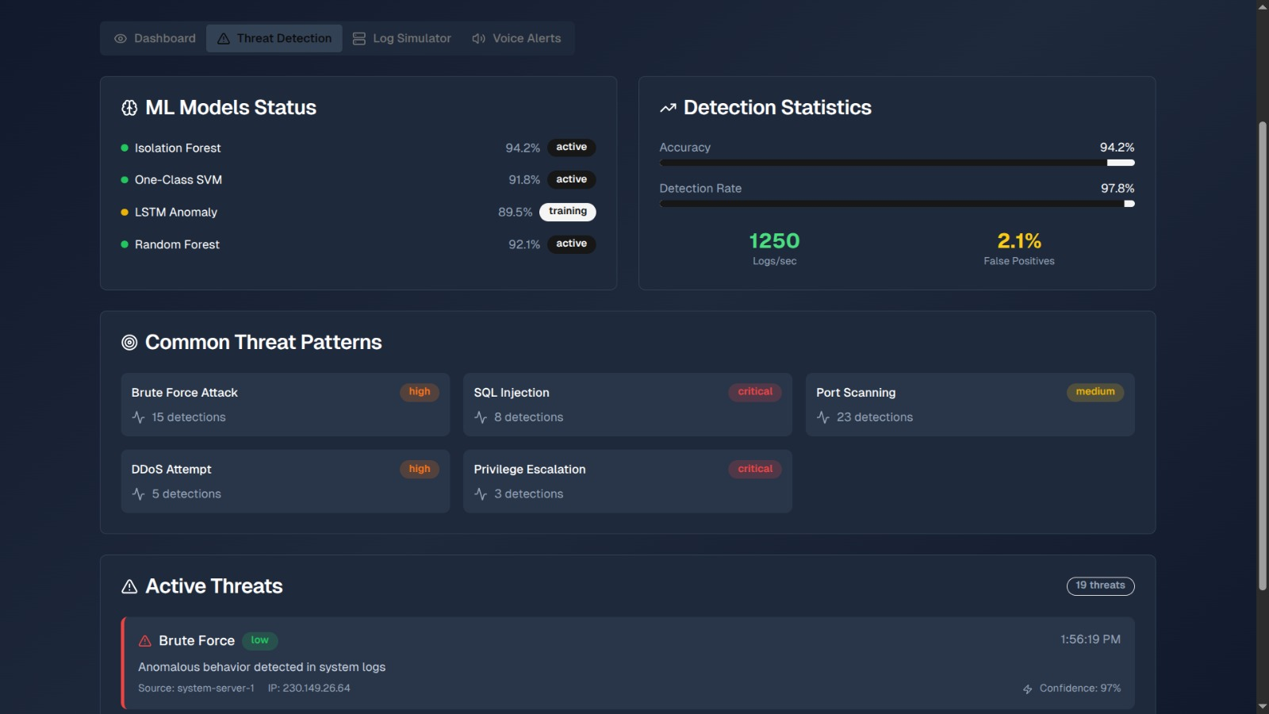
Interactive Dashboard and Visualisations
A dynamic dashboard provides immediate visibility into security posture and deep insights. OUR PROTOTYPE built till now:
Real-time Alerting: Customisable alerts and notifications for critical security events via multiple channels.
User Risk Scoring: Dynamic scoring for individual users based on their behaviour patterns, highlighting high-risk accounts.
Customisable Views: Tailored dashboards for different SOC roles and operational needs.
Attack Timeline & Root Cause: Visualise event flow graphs and maps incidents to the MITRE ATT&CK framework for comprehensive understanding.

Slide 8
Innovative Features and Scalability
Our solution incorporates advanced capabilities and is engineered to manage vast datasets and real-time streams efficiently.
Explainable AI (XAI)
Log Compression & Smart Storage
Provides transparent justification for every alert
Alerts are enriched with SHAP-based insights to improve analyst trust.
Achieves 30–50% compression by identifying and collapsing repetitive pattern. Retains essential context for forensic investigation and replay
Deception Detection
Scalable Processing
Integrates with honeypot systems to identify and alert on interactions with decoy assets, catching advanced attackers.
Designed to handle high-volume real-time log streams and large historical datasets. Leverages PySpark for distributed, high-throughput log processing

Slide 9


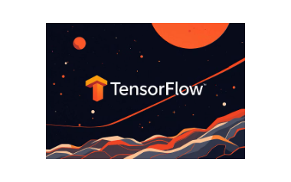





Implementation Tools and Technologies
Leveraging robust open-source tools ensures cost-effectiveness, flexibility, and community support for continuous improvement.
Data Layer: ELK Stack (Elasticsearch for storage, Logstash for ingestion/parsing, Kibana for querying), PySpark for distributed processing.
ML/Anomaly Detection Layer: TensorFlow/Keras for models (e.g., autoencoders, Isolation Forest), PyCaret for prototyping and tuning, Scikit-learn for algorithms, SHAP for explainable AI (XAI), NetworkX for attack timelines.
GenAI Layer: Hugging Face Transformers (e.g., GPT-2 for fine-tuning), Llama.cpp for on-prem LLM efficiency.
Visualization/Dashboard Layer: Streamlit for interactive dashboard, Plotly for charts and visualizations.
Scalability and Deployment: Docker for containerization and Compose for orchestration, Git for version control.
Core Programming: Python (with libraries like Pandas, NumPy for data handling).
Testing/Additional Tools: Black for code linting, Kafka mock for simulating streams.

Slide 10
Conclusion & Next Steps
This solution will transform your log analysis capabilities, providing robust, real-time threat detection and enhanced SOC efficiency.
Key Benefits
Next Steps
Significantly reduced false positives and improved detection accuracy.
Detailed architectural deep dive and infrastructure planning.
Enhanced SOC analyst efficiency through automation and GenAI assistance.
Proof of Concept (PoC) development with a sample dataset.
Proactive threat hunting and root cause analysis capabilities.
Phased implementation roadmap and resource allocation.
Scalable, secure, and transparent on-premise operations.

